Slide 1
In situ Visualization and Analysis of Ion Accelerator Simulations using Warp and VisIt
O. Rubel, B. Loring, J. Vay, D. P. Grote, R. Lehe, S. Bulanov, H. Vincenti, W. Bethel

Slide 2
WarpIV
a state of the art insitu vis and analysis application
couples Warp laser plasma simulation to insitu visualization tools
provides optimized i/o and analysis
provides domain specific functionality, eg. filters, Yee cell support
written in a mix of Python and C++. User only sees the Python side.
provides a structured/uniform interface to Warp, includes a number of example.
can be used “live” or in batch
runs on any system from laptop to Cray SuperComputer

Slide 3
Emerging Science: Ion beam acceleration
can be used in many applications!
including cancer therapy
potential advantages cancer therapy
precise control over depth at which energy is deposited results in less tissue damage
relatively compact and cheap
An active area of research, simulations are used to develop and prove theory and will eventually model experimental apparatus
Heavy ions,
accelerated
by the light
pressure
Electrons, expelled from the focal spot
Laser Pulse
Protons, accelerated
by the moving
charge separation field
Foil
simple idea: use a laser to create a plasma. charge separation accelerates ionized hydrogen
S. S. Bulanov, et al. “Accelerating monoenergetic protons from ultrathin foils by flat-top laser pulses in the directed-coulomb-explosion regime,” Phys. Rev. E, vol. 78, p. 026412, Aug 2008.

Slide 4
Insitu Vis and Analysis of Ion Beam Accelerater
2D simulations are often used in theoretical development
computational costs are low
2D datasets are small
easy to analyze on a workstation using familiar tools
3D simulations more accurately model the situation
very computationally expensive
very large datasets are produced
analysis is challenging, need parallel vis tools, and supercomputing
Are 2D simulations of the ion beam accelerator good enough?
O. Rubel et al, “In situ Visualization and Analysis of Ion Accelerator Simulations using Warp and VisIt”, IEEE CG&A, SPECIAL ISSUE ON HIGH PERFORMANCE VISUALIZATION AND ANALYSIS, SEPTEMBER 2015 (submitted)

Slide 5
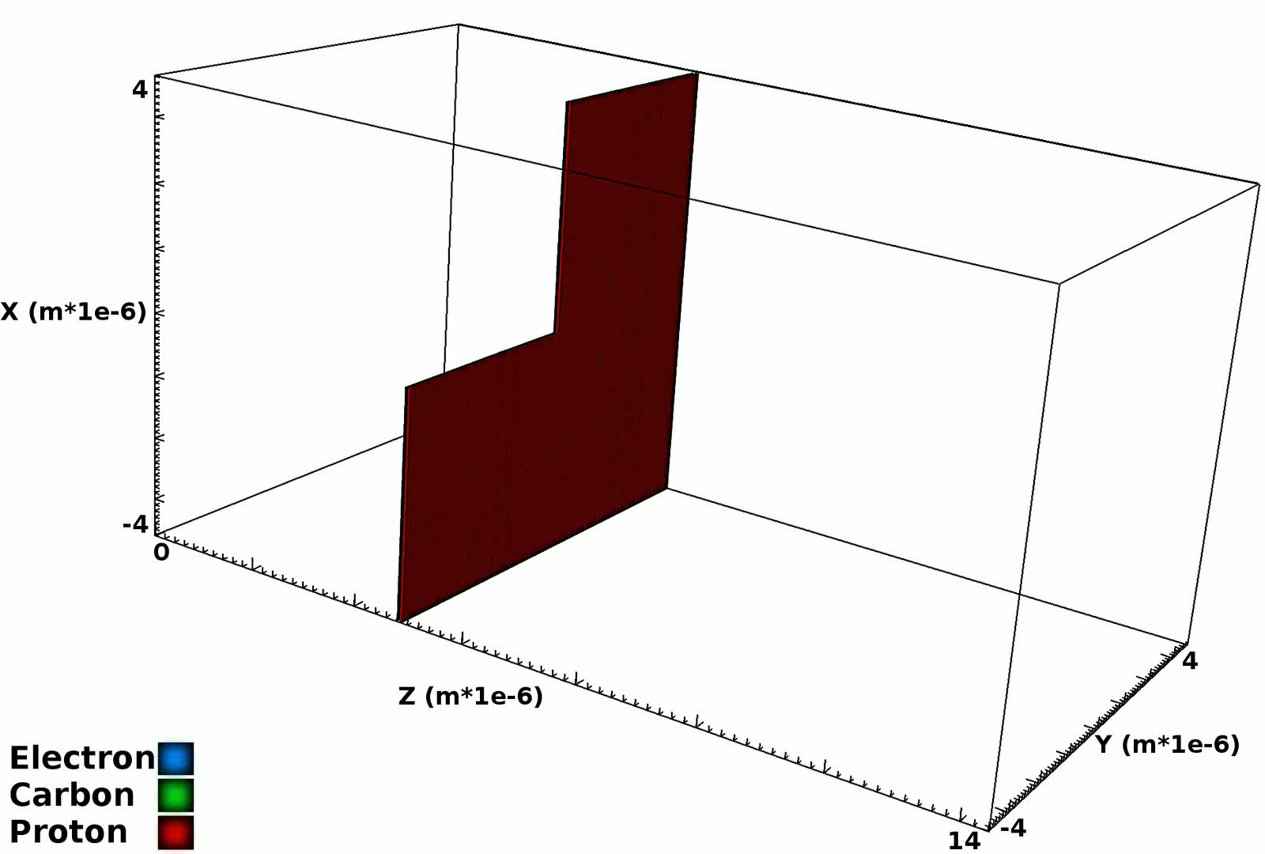
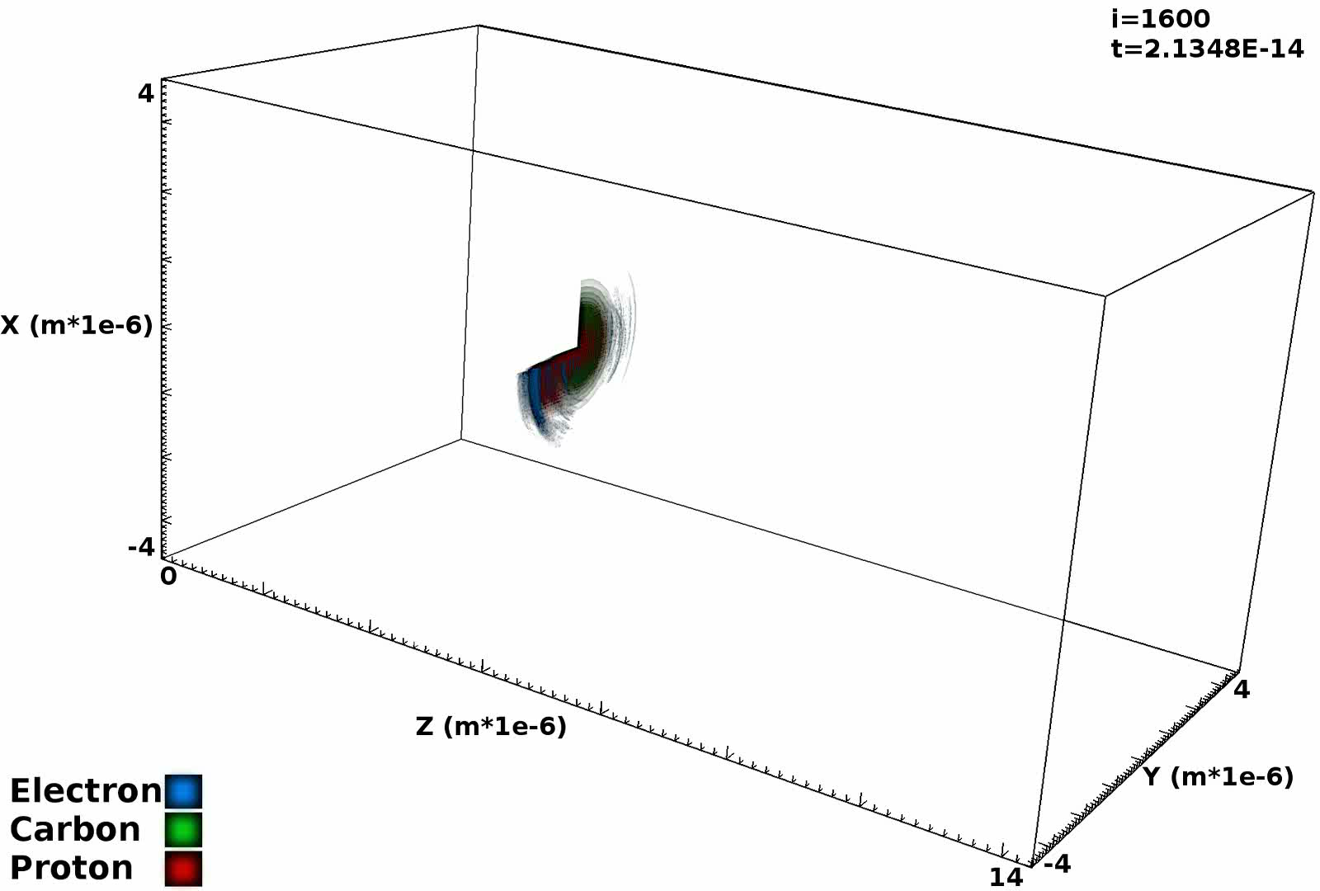
Visualization: Iso-surfaces
Particle Density
Kinetic Energy
Notes:
renderings of the 3d run. insitu rendering is challenging. could look better! but massive data reduction going from problem sized data to images.

Slide 6
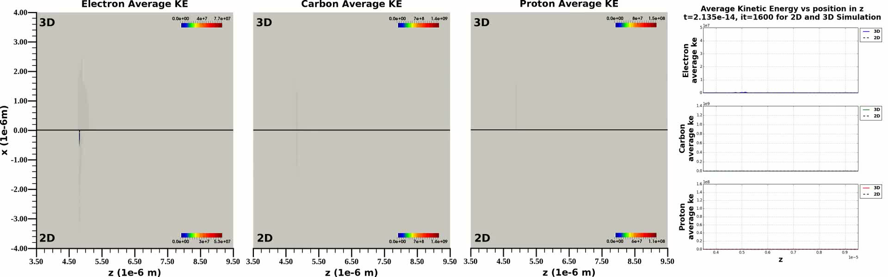
Analysis: Compare 3D and 2D simulation

Slide 7
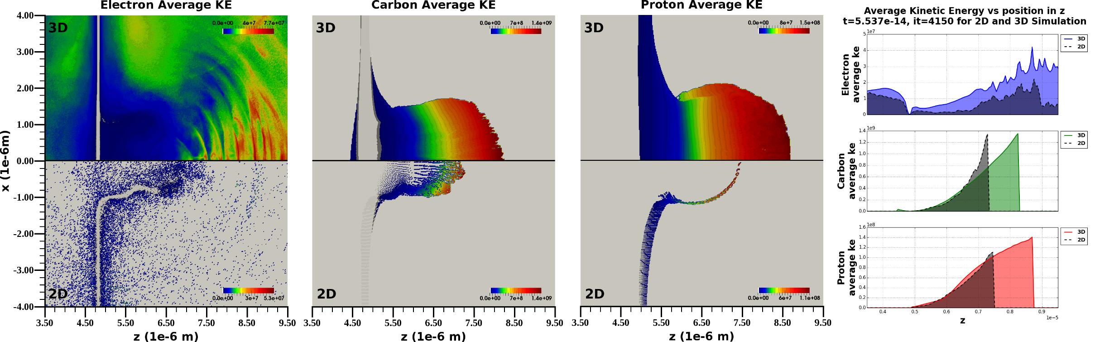
Are 2D simulations good enough?
In 3D higher energies are reached, the beam propagates faster and further over the same time period. 2D is qualitatively similar.
Notes:
Maybe! But there are some substantial differences that suggest 3D is important in this application. in 2d beam is narrower and nearer the source, you may not be able to do accurate targeting or device design using 2d sims.

Slide 8
Why insitu? What are the challenges?
increase temporal resolution and at the same time realize I/O reduction
rendering, reduces problem sized data to image sized data
fast, small, serial I/O, doesn’t impact file system.
but hard to get it right without a lot fiddling and fine tuning
“extracts”, derived quantities, reduced geometry etc
focused analysis, do exactly what you need, write exactly what you need
often smaller, but not always
different I/O properties than simulation itself
render it later, so you can get the best result

Slide 9
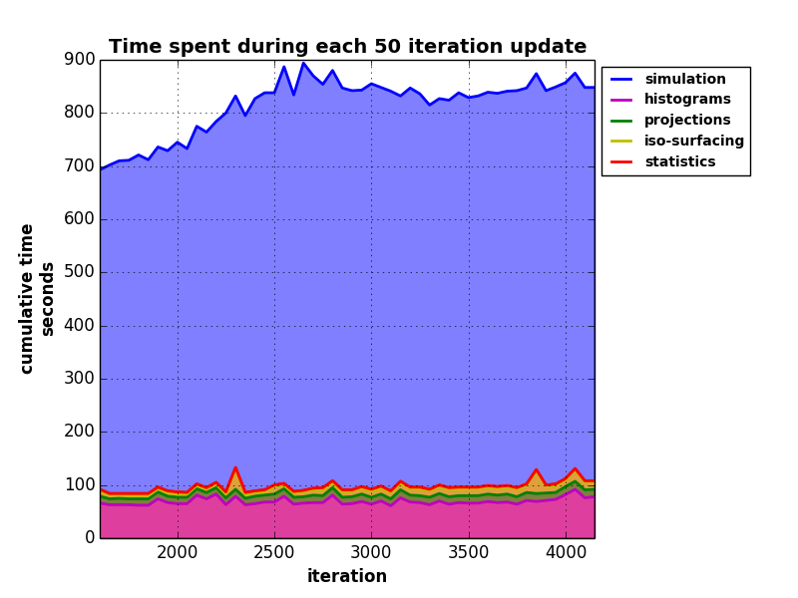
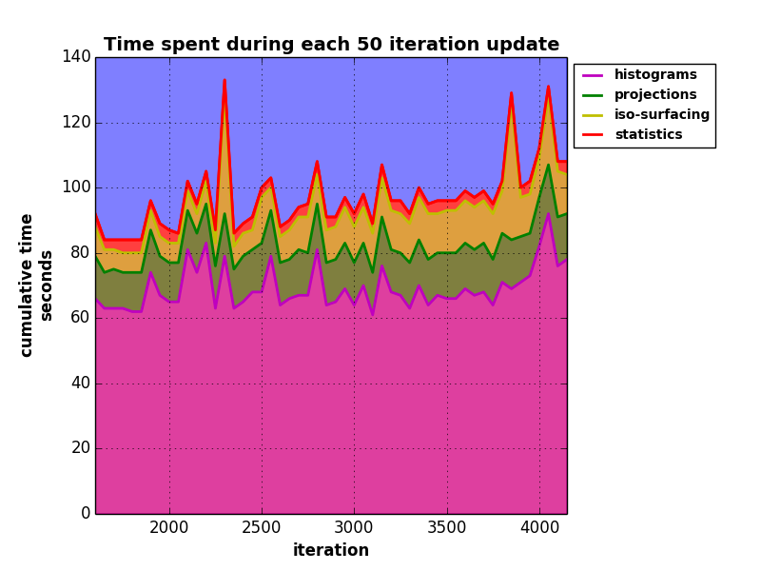
How did we do?
Notes:
this shows times from the 3d run of the simulation (big blue) and
12 histograms, 18 projections, renderings of 2 fields (den and ke) 20 iso-surface values with an alpha ramp
figure on the right is zoom in of fig on lerft
insitu is not free but not so bad relative to the sim either.
getting rendering to that point was a ton of work!

Slide 10
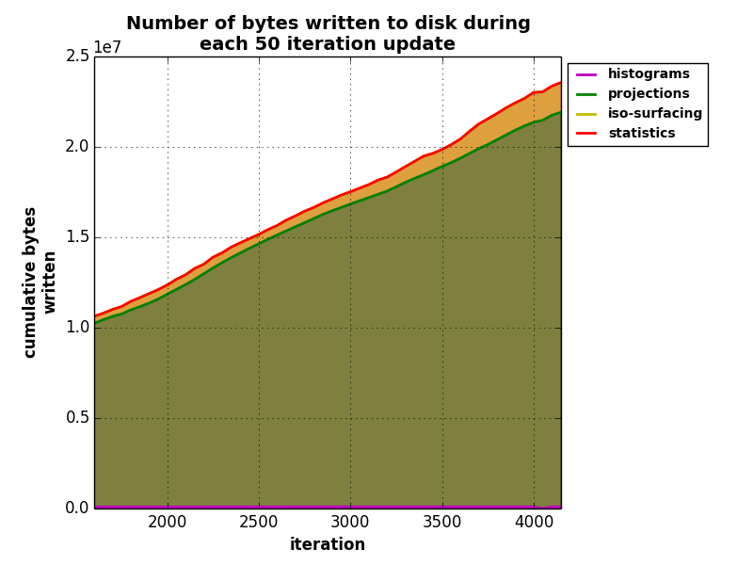
What about I/O?
Category | Actually written to disk
histograms | 4.48984 MB
projections | 795.969 MB
iso-surfaces | 40.7662 MB
statistics | 3484 b
total | 841.228 MB
To do this post process we would have written 3.2 TB to disk to capture the minimum amount of data to do the same analysis.
Insitu bought us a 4033 times reduction in I/O.
Notes:
this shows times from the 3d run of the simulation (big blue) and
12 histograms,
18 projections
renderings of 2 fields (den and ke) 20 iso-surface values with an alpha ramp
the amount of the projections increases because its easier for zlib to compress early in the sim, particles are concentrated in the sheet, the rest of domain is empty.

Slide 11
Rendering performance is critical insitu
Rendering is challenging insitu! Many parameters to fine tune to get a nice looking(usable) result.
it’s hard to fine tune rendering in advance
you are essentially working blind
Rendering has some of the biggest opportunity for data reduction while capturing 3D nature of the data
With insitu rendering you may need to render more to ensure you get the result
need to look at more fields
maybe from different angles
Notes:
there are some research techniques to alleviate some of this, nothing in production.

Slide 12
Rendering improvements for VisIt & libsim
Alpha compositing capability, and improved depth compositing
SIMD vectorization, threads overlap comm and composite
Ordered compositing optimization, eliminates the need for global redistribution of data. lets you render in place.
Optimized camera order depth sort in VTK
transform qsort to std::sort lets comparisons be inlined
Use GetCellPoints instead of GetCell. minimal overhead to compute cell depth, and eliminates calls through VTK’s virtual API
SIMD vectorization, templatization
Notes:
these mostly target transparent rendering.

Slide 13
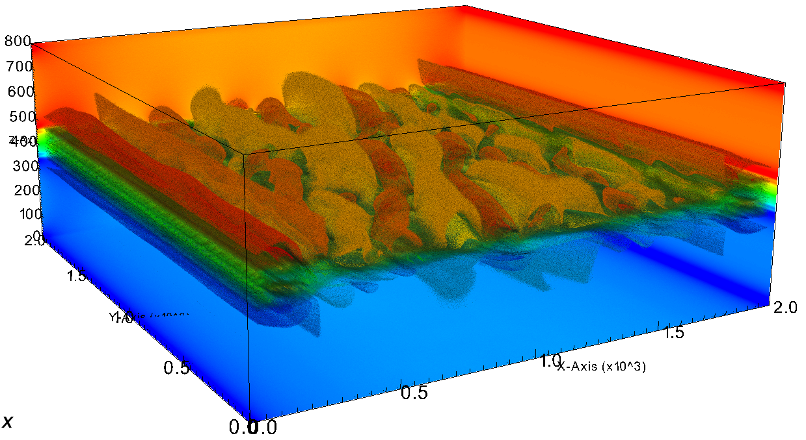
Testing the improvment
2000^2 x 800 plasma dataset
512 cores on Edison
3 opaque slices
20 transparent iso-surfaces
data is rotated in ½ deg increments
average time over 20 frames

Slide 14
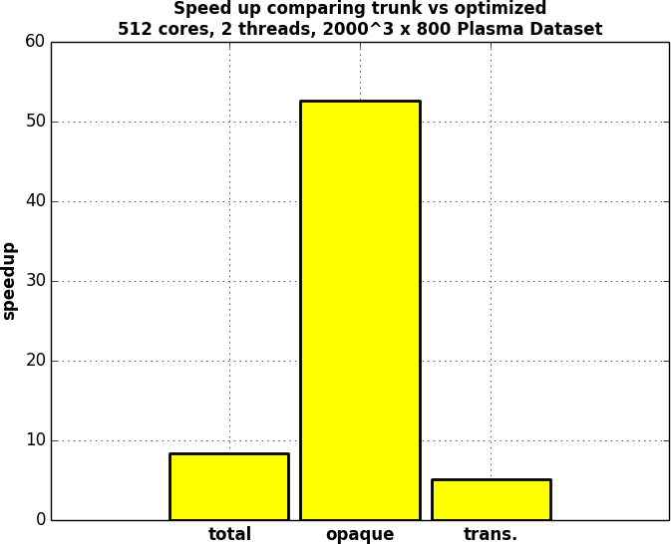
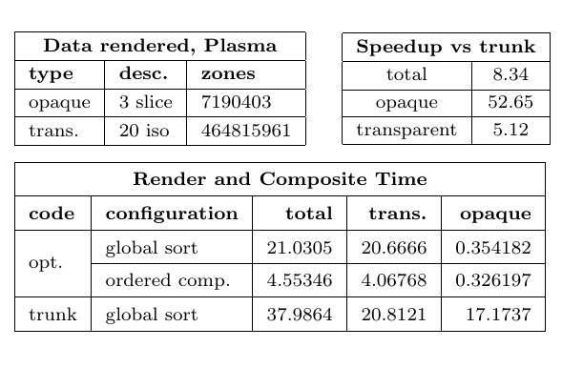
The result

